Slide 1
Lab meeting – 5th August 2022
Research update by Mukta

Slide 2
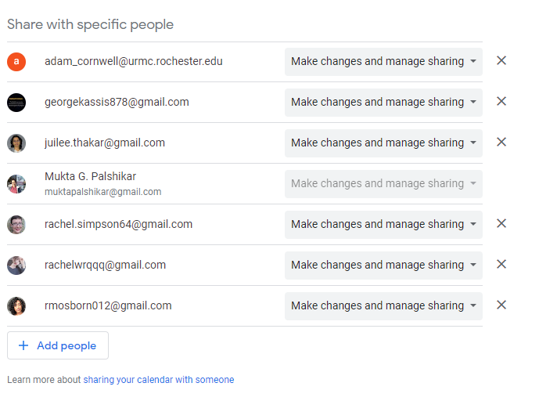
First, some admin -
These are the users with current access to the lab calendar
Everyone can & should add/remove users as needed!

Slide 3
Executable models of signaling pathways built using omics data
Mukta G. Palshikar

Slide 4
Timeline for my last four months in the lab
Project/Month | August | September | October | November | December
moBONITA | Finish project & get manuscript on biorxiv | Submit manuscript | Revise/resubmit as required | Prepare for defense – need two practice sessions at lab meeting
Thesis | Finish writing thesis |  | Submit thesis: Oct 24th |  | Defense: Dec 1st Termination date: Jan 11th

Slide 5
Summary of thesis aims
Aim 1:
Build executable models of pathways using single-cell RNA-seq data to study atherosclerosis-associated signaling dysregulations
Aim 2:
Develop methods to build an integrated network using transcriptomics, proteomics, and phosphoproteomics data

Slide 6
Summary of thesis aims
Aim 1:
Build executable models of pathways using single-cell RNA-seq data to study atherosclerosis-associated signaling dysregulations
Aim 2:
Develop methods to build an integrated network using transcriptomics, proteomics, and phosphoproteomics data

Slide 7
Aim 1: Build executable models of pathways using single-cell RNA-seq data to study atherosclerosis-associated signaling dysregulations (scBONITA)
scBONITA manuscript accepted!
In progress – applications of scBONITA to find network-specific signaling states of B cells

Slide 8
Summary of thesis aims
Aim 1:
Build executable models of pathways using single-cell RNA-seq data to study atherosclerosis-associated signaling dysregulations
Aim 2:
Develop methods to build an integrated network using transcriptomics, proteomics, and phosphoproteomics data

Slide 9
Cyclosporine A Directly Affects Human and Mouse B cell Migration in vitro by Disrupting a HIF-1α Dependent, O₂ Sensing, Molecular Switch
Hypoxia is a potent molecular signal for cellular metabolism, mitochondrial function, and migration.
Hypoxic conditions trigger regulatory and differentiation cascades in human B cells mediated via the hypoxia-inducible factor 1 alpha (HIF-1α) transcriptional cascade
Calcineurin inhibitors such as cyclosporine A destabilize HIF1-A and suppress B cell responses to infection
Unbiased omics experiments were conducted to examine global expression changes
Does cyclosporine A (condition 3) restore protein expression programs usually seen under normal oxygen tension (condition 1)?
Network-based integration of multiomics data suggests a mechanism for HIF-1α-mediated chemotaxis in B cells
Collaboration with Zand lab (UofR), Jun Qu lab (Buffalo)

Slide 10
Unbiased omics experiments to examine global expression changes under different combinations of treatments
O₂ levels | CyA | CXCL12
 |  | No CXCL12 | 15 min of CXCL12 | 30 min of CXCL12
19% | + | Phosphoproteomics Transcriptomics | Phosphoproteomics | Phosphoproteomics
 | - | Phosphoproteomics Proteomics Transcriptomics | Phosphoproteomics | Phosphoproteomics
1% | + | Phosphoproteomics Proteomics Transcriptomics | Phosphoproteomics | Phosphoproteomics
 | - | Phosphoproteomics Proteomics Transcriptomics | Phosphoproteomics | Phosphoproteomics
Experimental conditions in the three datasets from RAMOS B cells

Slide 11
2 ½ manuscripts describe statistical analysis of the three omics datasets…

Slide 12
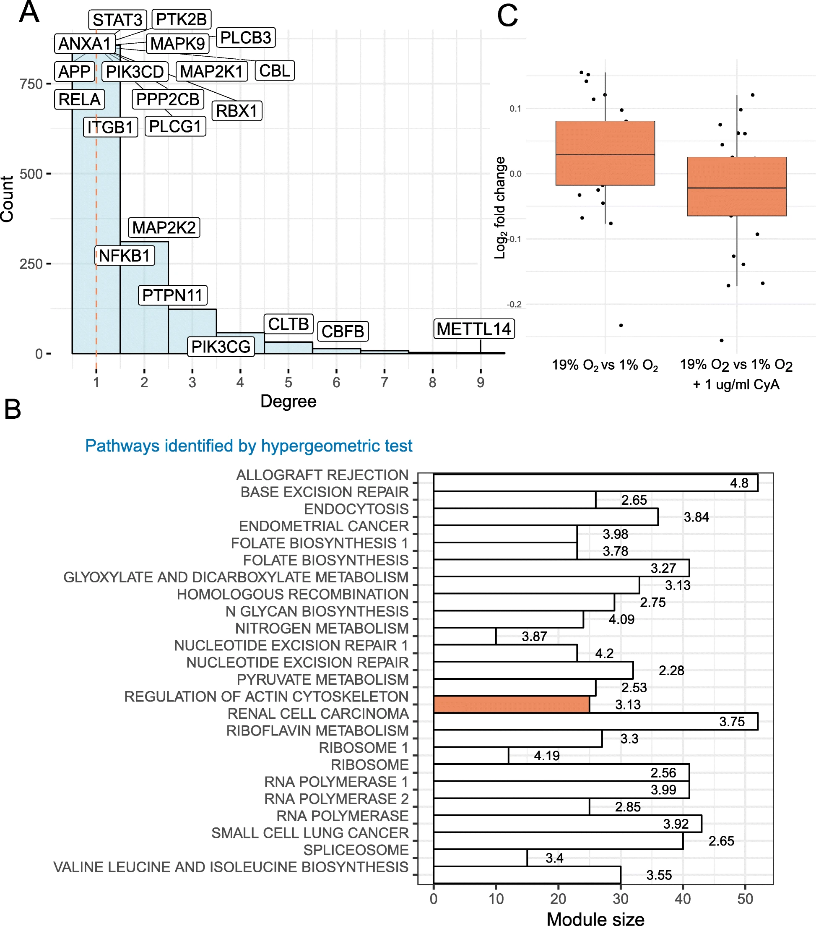




Protein association networks show that actin cytoskeletal rearrangement is disrupted by CyA
To circumvent the issue of not having gene sets that were significantly dysregulated between conditions:
Constructed a protein association network
Identified & characterized a module of genes linked to cytoskeletal rearrangement with significantly different fold changes in 19% O₂ vs 1% O₂ and 19% O₂ vs 1% O₂ + CyA contrasts
Hilchey, S. P., M. G. Palshikar, J. A. Emo, D. Li, J. Garigen, J. Wang, E. S. Mendelson, V. Cipolla, J. Thakar and M. S. Zand (2020). BMC immunology 21(1): 1-18.

Slide 13
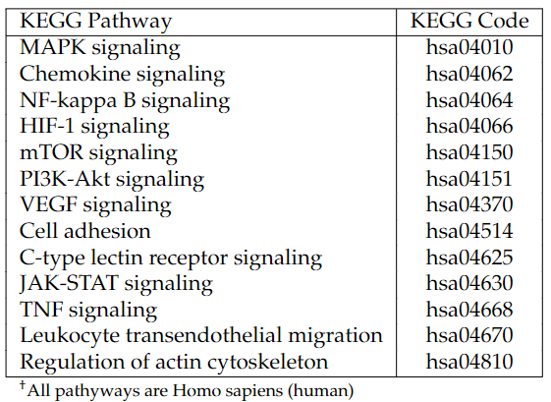
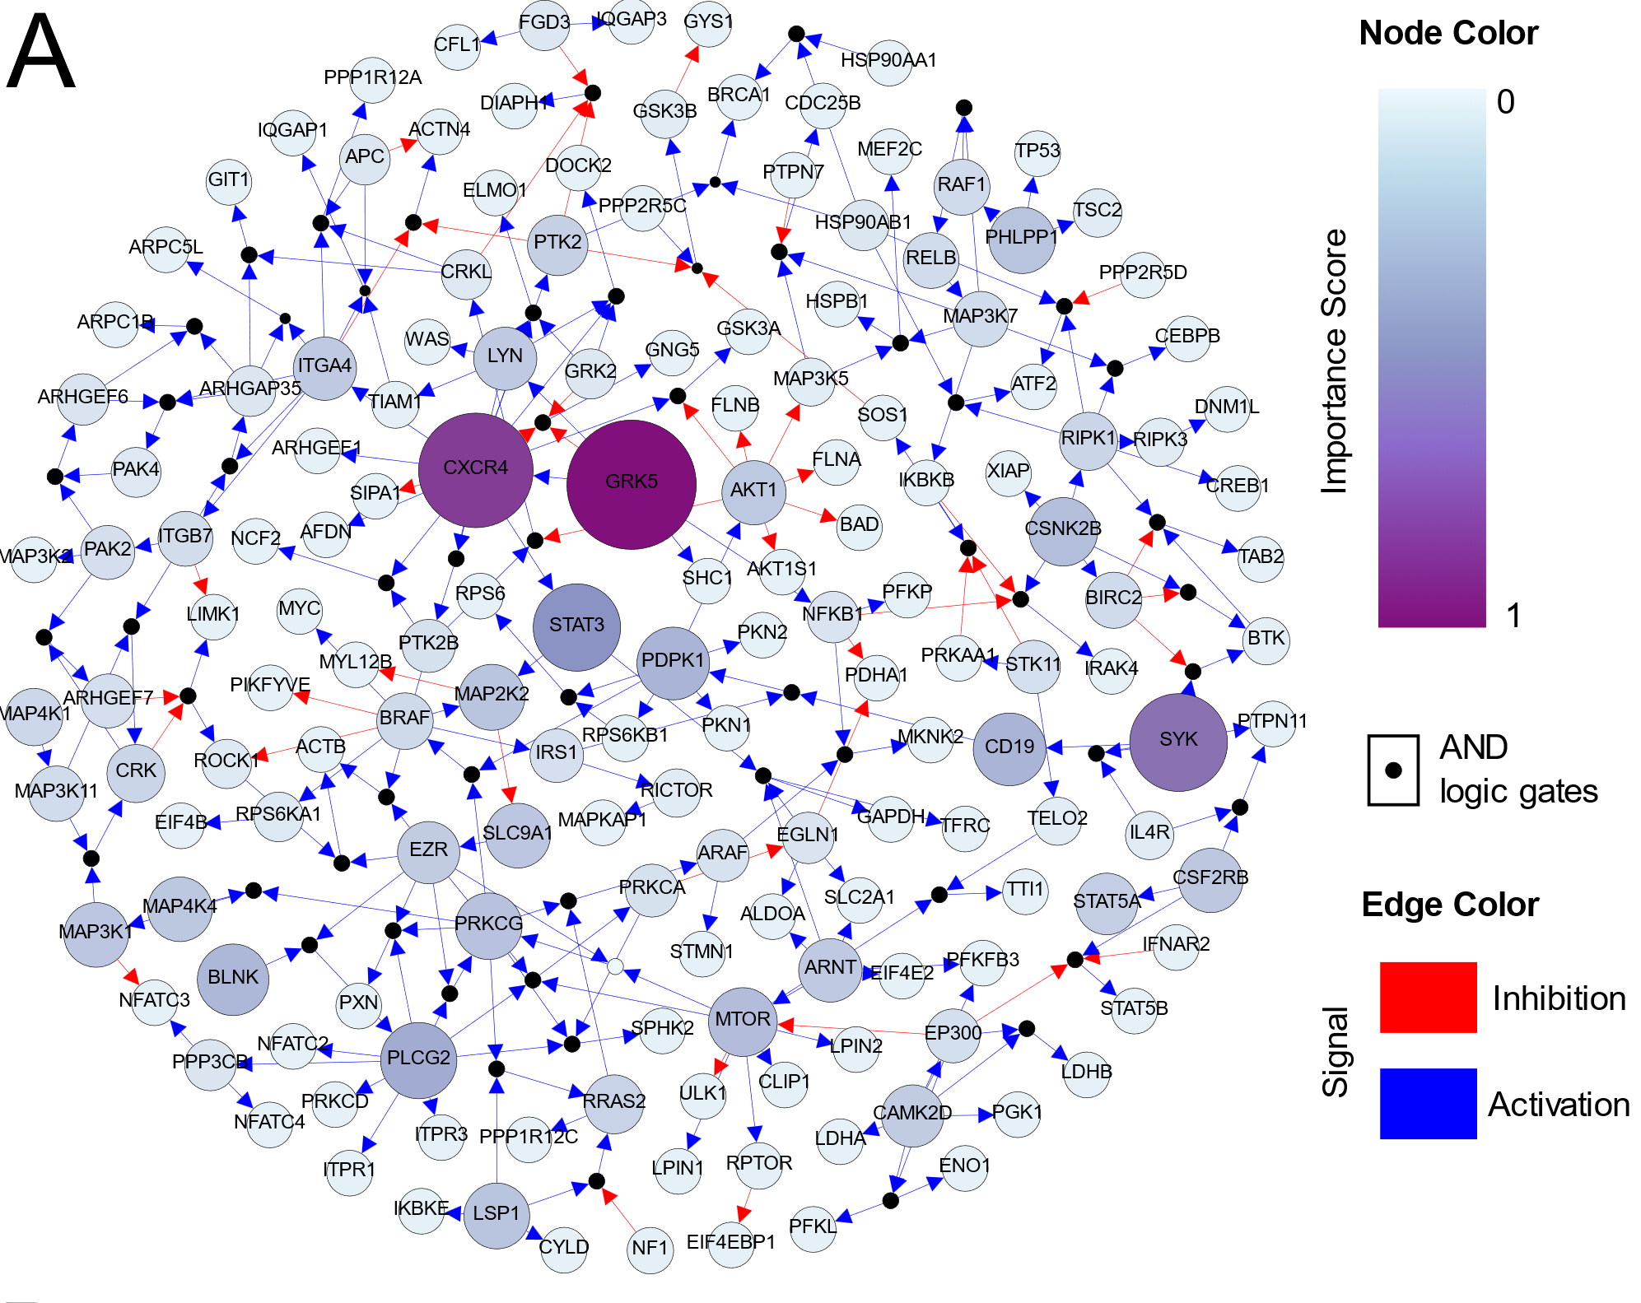
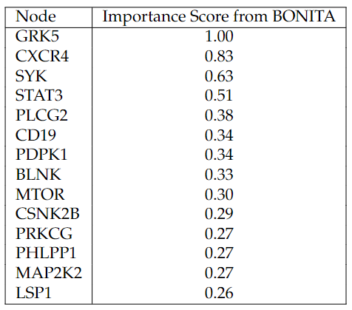

Discrete State Modeling Of A Network Linking HIF1A Signaling With Cytoskeletal Changes With Phosphoproteomics Data
Hilchey, S. P. & M. G. Palshikar, S. Shen, S. Rasam, E. S. Mendelson, J. A. Emo, J. Thakar, J. Qu and M. S. Zand (2022). Under review

Slide 14
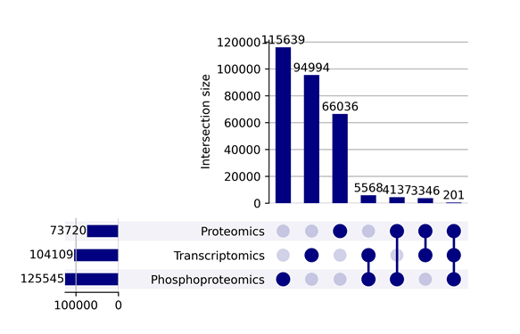
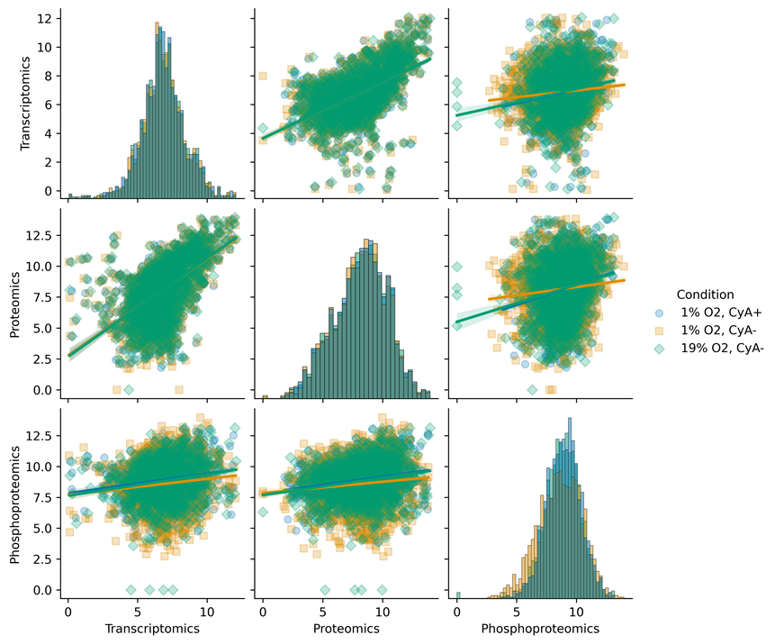
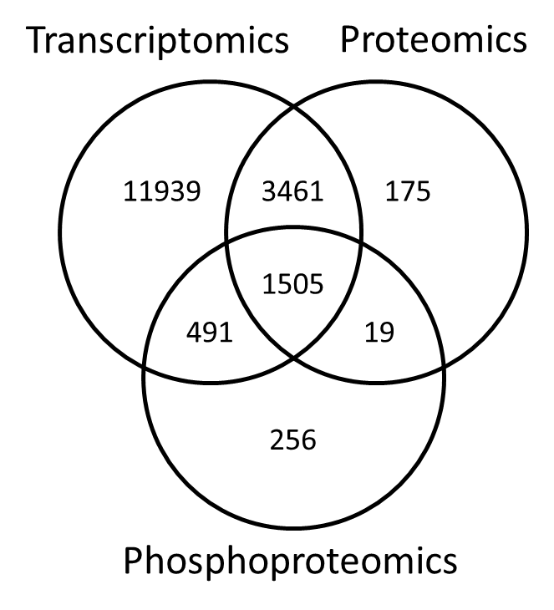
Comparison of omics datasets
C
A
B
(A) 1505 genes were profiled in all three omics datasets (median log2-abundance > 0) (B) The multi-omics datasets showed low inter-dataset correlations. Distinct experimental conditions are indicated by colors and shapes as shown in the legend. (C ) Correlation networks constructed using three multi-omics datasets showed little overlap between edges.

Slide 15
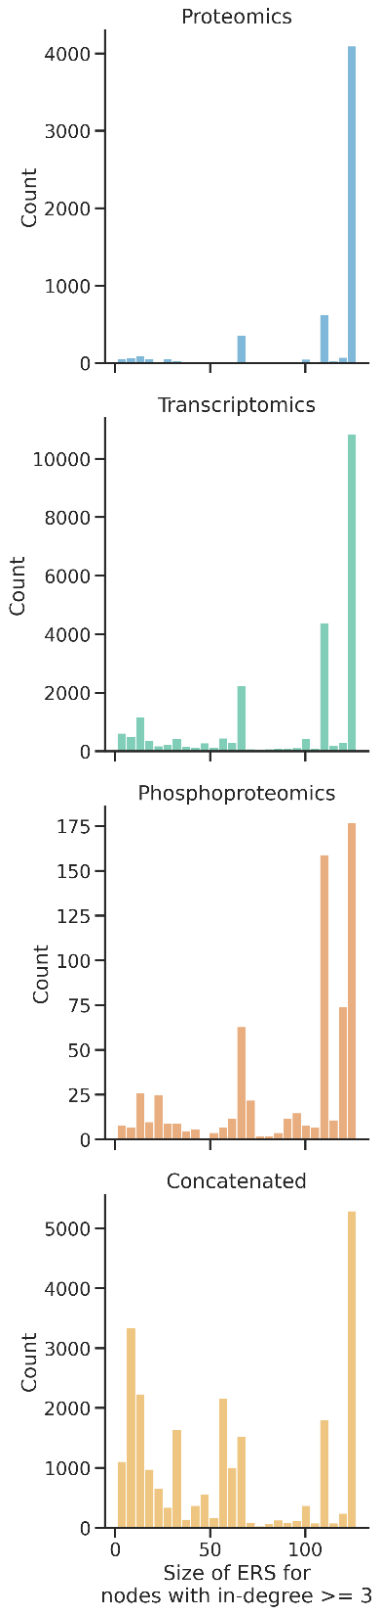
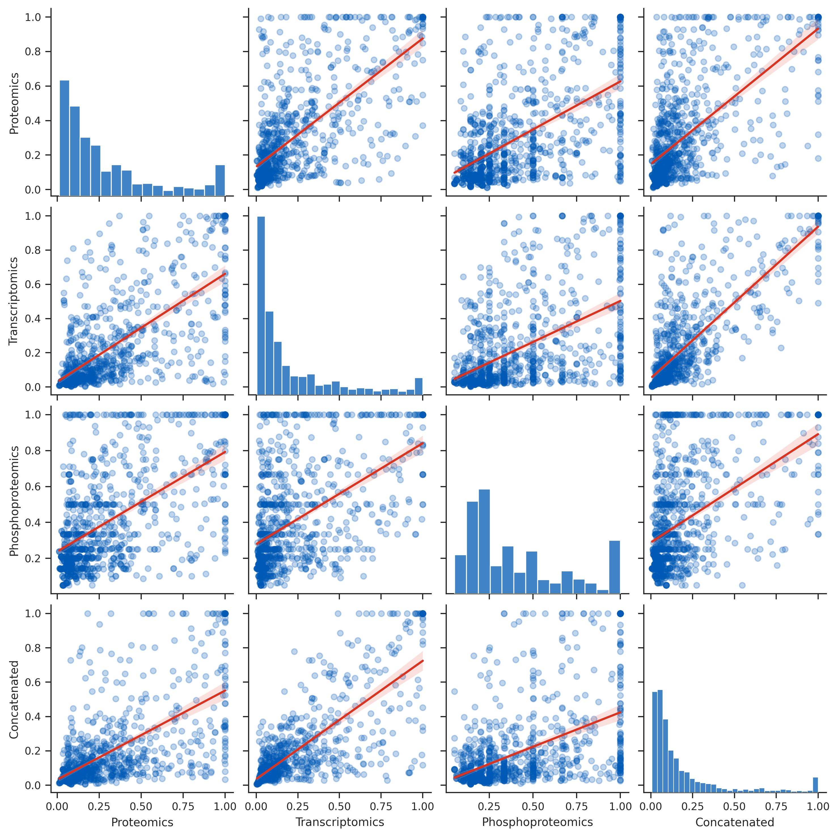
Rule inference with BONITA from all three datasets
A
B
BONITA was used to infer Boolean rules for all three omics datasets individually and combined.
Rule set sizes
Importance scores (Spearman correlations between 0.5 and 0.8, p << 0.01)

Slide 16
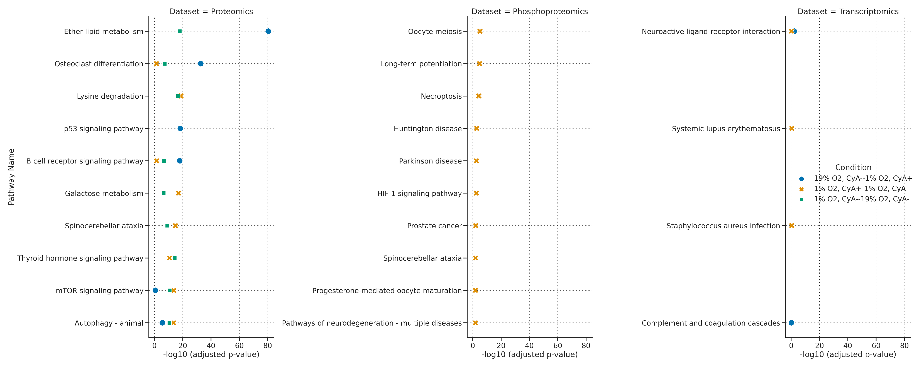
Pathway analysis with BONITA (individual omics datasets)
A
B
C
All p-values are Bonferroni-corrected and are < 0.01. From left to right: (A) Proteomics, (B) Phosphoproteomics and (C) Transcriptomics

Slide 17
Motivation & Significance of mBonita
multi-omics Boolean Omics Network Invariant Time Analysis (mBONITA) can effectively use this multi-omics dataset in combination with prior knowledge networks to
identify an accurate and reliable regulatory/Boolean rule set for PKNs
use this improved rule set to calculate node modulation scores that incorporate measurements from multiple omics assays and the network topology
use these modulation scores to identify dysregulated pathways that suggest a mechanism for hypoxia-mediated chemotaxis in B cells

Slide 18
Two strategies to infer Boolean rules from multi-omics data
Using BONITA’s genetic algorithm strategy to identify overlapping rules
Combine multi-omics datasets into a single interpretable dynamic model
Prior knowledge networks
Simulation, perturbation, importance scores, pathway analysis
Using a neural network + prior knowledge networks to infer a network model

Slide 19
mBONITA integrates information from multiple datasets to simulate and perturb a prior knowledge network with a consensus set of logic rules
GOAL
INPUT DATA
DATA INTEGRATION
OUTPUT
Gene expression
Node modulation scores
Combine multi-omics datasets into a single interpretable dynamic model
Simulation with a consensus set of logic rules
Ranked dysregulated pathways
Protein abundance
Protein modifications
Dysregulated subnetworks

Slide 20
Work in progress & future directions
Discouraged by the lack of a consistent topology between BONITA experiments and the consequent low overlap in inferred rules, plus the usual ambiguity in inferred rules
Tried to mitigate the latter by using ‘minimal rules’ but this seems less than satisfying
Planning to go back to simply overlapping rules and forcing a resolution of topology by maximizing the number of upstream nodes
Had some plans to compare the importance scores to scores from other multi-omics integration methods but in the interests of time it might be best to stick to comparison to BONITA scores and compare pathway analysis results

Slide 21
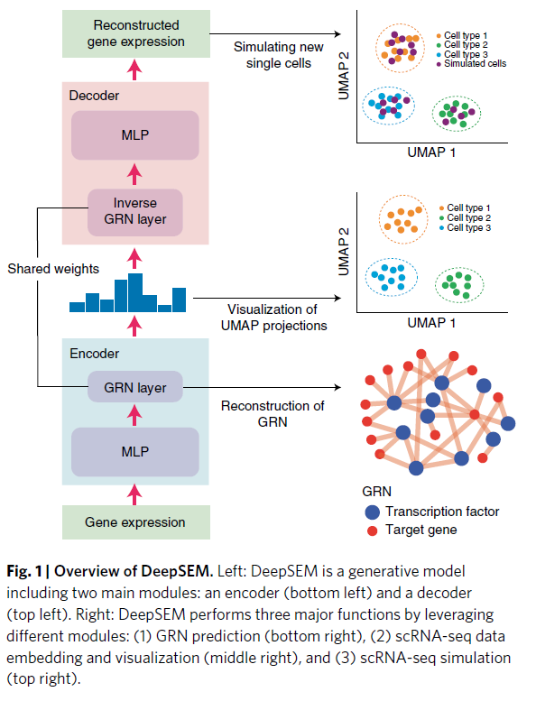
Neural networks to infer logic rules (or some functions…) for a PKN
Currently trying to use a prior knowledge network (PKN) + a definitely not optimized neural network architecture to learn logic rules instead of a genetic algorithm/local search like BONITA
Advantages –
High accuracy; much faster; single easy-to-reuse network model
Disadvantages –
not straightforward to examine learned rules individually (frankly this is the case with BONITA as well)
Shu, H., J. Zhou, Q. Lian, H. Li, D. Zhao, J. Zeng and J. Ma (2021). "Modeling gene regulatory networks using neural network architectures." Nature Computational Science 1: 491-501.

Slide 22
Generate test and training datasets
Generate fake single cells from the three omics datasets according to the probability of activation of each gene
Incorporate prior knowledge network –
Features – transcript & phosphopeptide abundance of upstream nodes (essentially the expression matrix multiplied by the adjacency). Add self-edges to nodes with in-degree = 0.
Labels – protein abundance of downstream nodes
So - accuracy of prediction is a measure of how well the learned function of upstream nodes predicts the state of the downstream node
75-25 split between training and test datasets

Slide 23
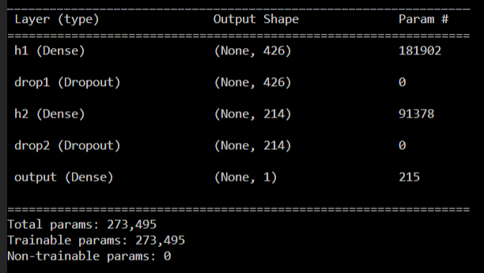
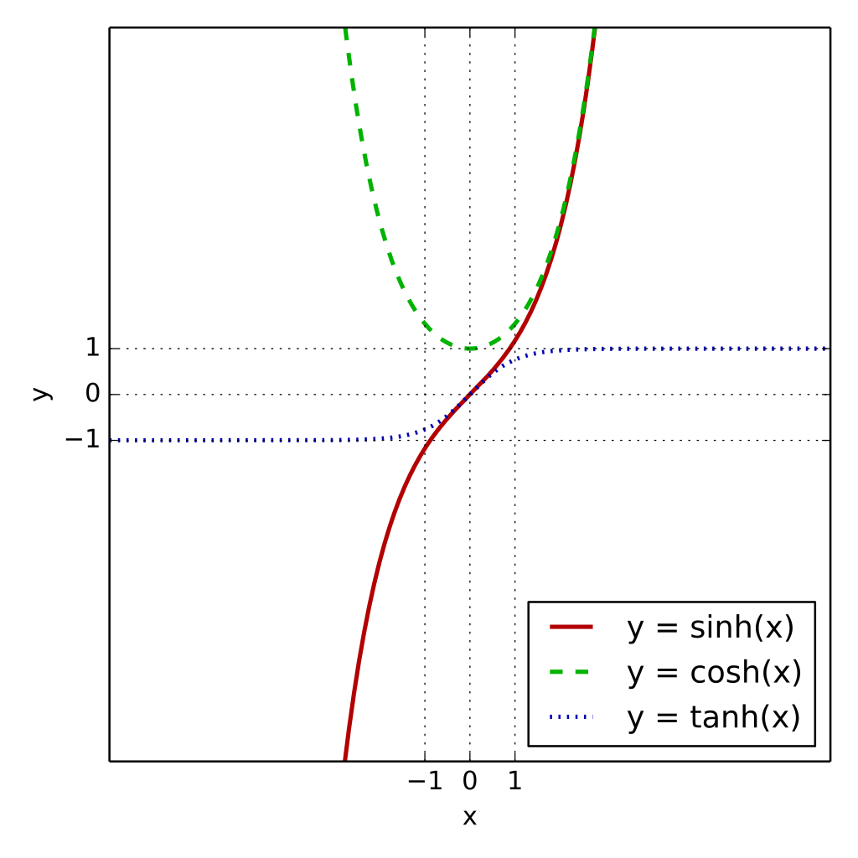
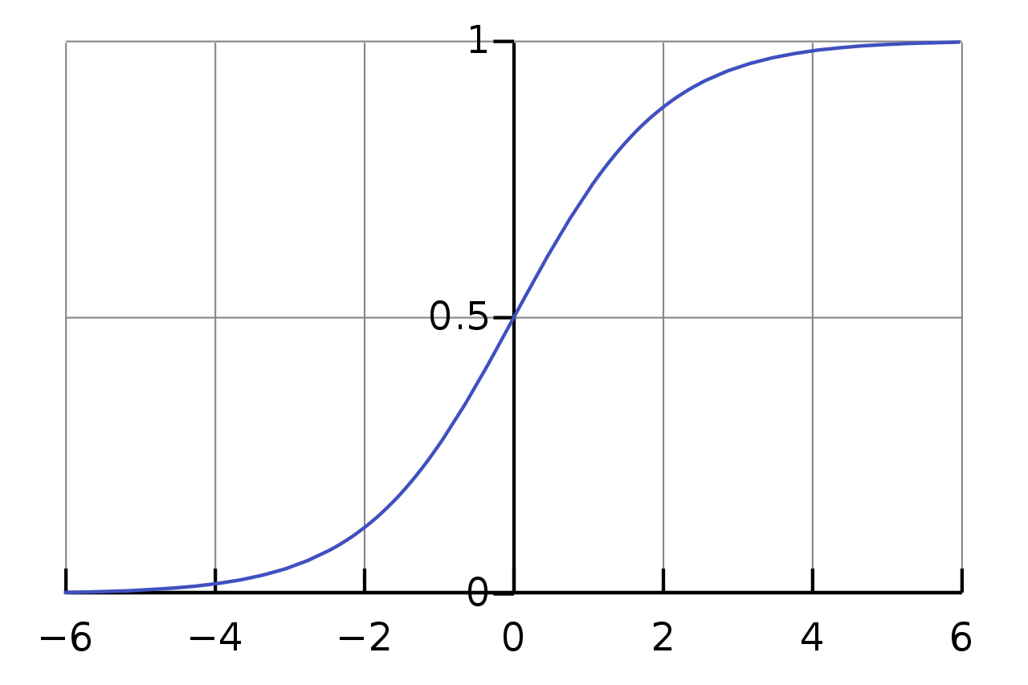
NN architecture – room for improvement.
Dense
Activation: tanh
Dropout
Rate: 0.2 (might want to increase this rate…)
Dense
Activation: Sigmoid
Dropout
Rate: 0.2
Output
Activation: Sigmoid
Loss = mean absolute error
Metric = binary accuracy (frequency of correct predictions)
Notes:
probability at which outputs of the layer are dropped out, or inversely, the probability at which outputs of the layer are retained.
If a unit is retained with probability p during training, the outgoing weights of that unit are multiplied by p at test time
sigmoid(x) = 1 / (1 + exp(-x))

Slide 24
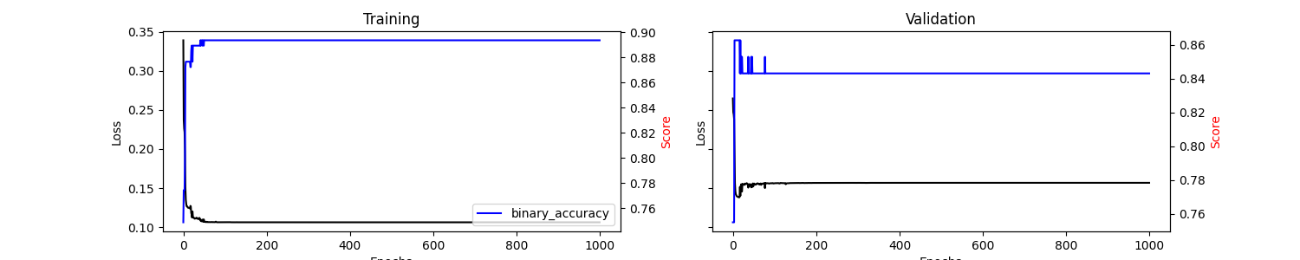
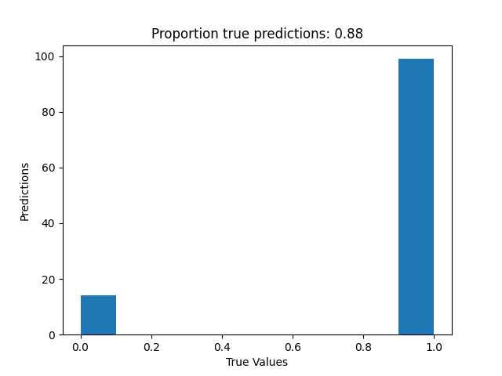
High accuracy at predicting state of network nodes as a function of their upstream nodes
Some (unquantified) variation depending on the sampling of training data. I haven’t seen it go below 0.8.
Epoch

Slide 25
Calculation of importance scores – Strategy & Results
For each node in the network:
Make predictions using a dataset of simulated knock-ins & knock-outs, calculate the difference between the two predicted states
Issues:
Not sure that this even makes sense
No consistency in predictions (this is a known tensorflow issue, related to loading saved models – didn’t have time to troubleshoot this yet)
No correlation with the usual measures of node influence – tested in-degree, out-degree, and out-degree centrality
Node | Knockout | Knockin | IS | indegree | outdegree
HSP90AA1 | 259 | 0 | 259 | 1 | 15
STK3 | 4 | 258 | 254 | 1 | 1
PTPN7 | 393 | 239 | 154 | 1 | 16
TAB2 | 240 | 355 | 115 | 11 | 2
MAP3K1 | 0 | 94 | 94 | 14 | 17
CSNK2B | 339 | 424 | 85 | 1 | 9
AKT1 | 0 | 17 | 17 | 40 | 32
PLCG2 | 404 | 393 | 11 | 9 | 32
ITGA4 | 394 | 403 | 9 | 3 | 25
GNG5 | 403 | 394 | 9 | 4 | 25
MAP3K5 | 395 | 404 | 9 | 3 | 6
TSC2 | 403 | 397 | 6 | 25 | 11
FLNB | 345 | 339 | 6 | 3 | 1
IL17RA | 244 | 248 | 4 | 1 | 1
RPS6KB1 | 248 | 244 | 4 | 3 | 4
PAK4 | 397 | 394 | 3 | 14 | 6
TFRC | 405 | 403 | 2 | 10 | 1
SPN | 404 | 406 | 2 | 1 | 1
IFNAR2 | 393 | 395 | 2 | 1 | 8
MIOS | 260 | 259 | 1 | 2 | 3
MAP4K2 | 259 | 260 | 1 | 1 | 1
PHLPP1 | 258 | 259 | 1 | 1 | 15
PPP2R5E | 394 | 393 | 1 | 1 | 15
STK4 | 406 | 405 | 1 | 1 | 1
GYS1 | 403 | 404 | 1 | 2 | 1

Slide 26
Future directions
Strongly leaning towards returning to our original strategy of combining rule sets from multiple BONITA experiments due to a severe time crunch and several other responsibilities
I have easy-to-follow code and a fluent setup to run the neural network experiments so it might be interesting to follow up later

